Slide 1
Unit 2
NUCLEIC ACIDS- DNA AND RNA

Slide 2
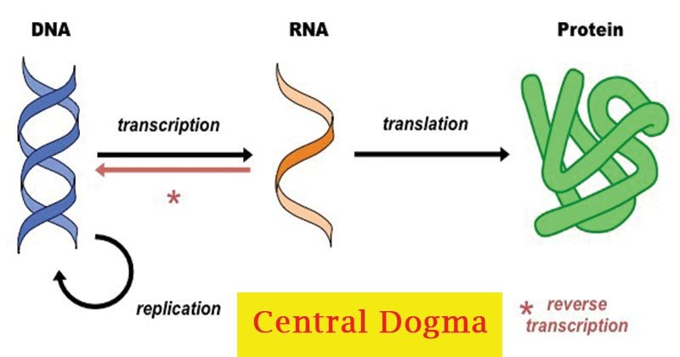

Slide 3
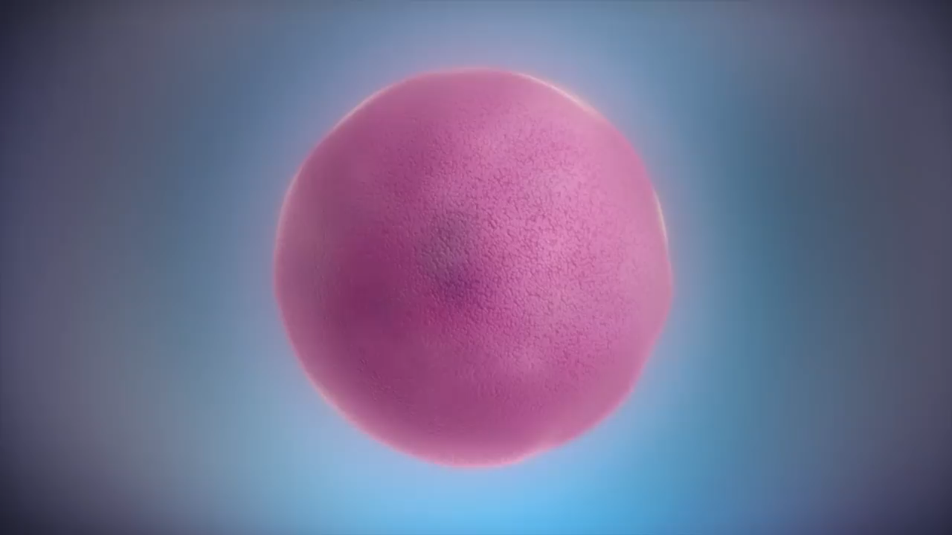
From DNA to Protein synthesis- video

Slide 4
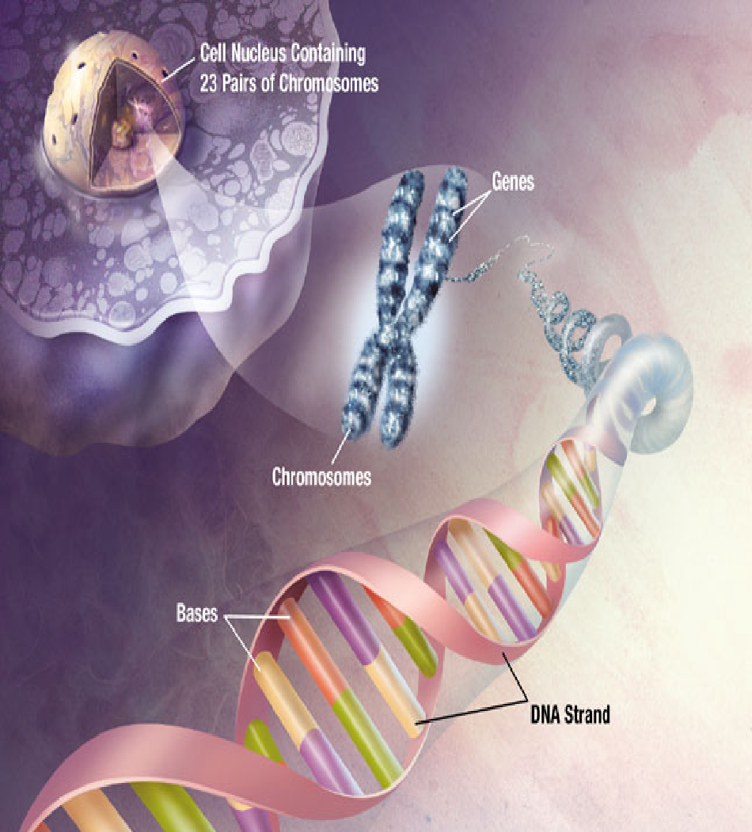
Nucleic Acids
Store hereditary information
Contain information for making all the body’s proteins
Two types exist --- DNA & RNA

Slide 5
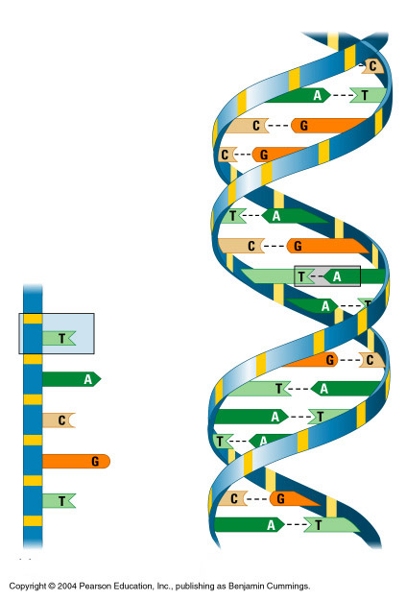
DNA-Deoxyribonucleic acid
Backbone
Two strands of DNA join together to form a double helix
Nucleotides form long chains called DNA
Nucleotides are joined by sugars & phosphates on the side
Nucleotide
Base
pair
Bases
DNA strand
Double helix

Slide 6
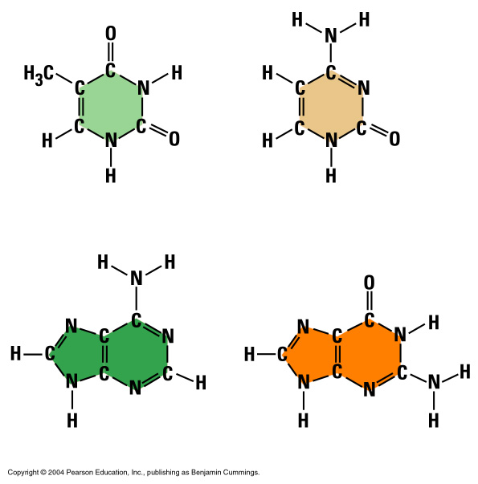
Bases
Each DNA nucleotide has one of the following bases:
PYRIMIDINES
Thymine (T)
Cytosine (C)
Adenine (A)
Guanine (G)
Thymine (T)
Cytosine (C)
PURINES
Adenine (A)
Guanine (G)

Slide 7
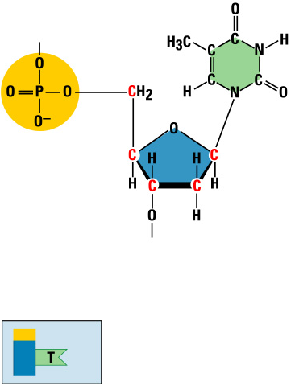
Nucleic Acids
Nitrogenous base
(A,G,C, or T)
Nucleic acids are polymers of nucleotides
Phosphate
group
Thymine (T)
Sugar
(deoxyribose)
Phosphate
Base
Sugar
Nucleotide

Slide 8
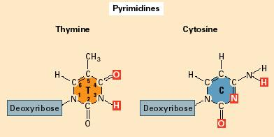
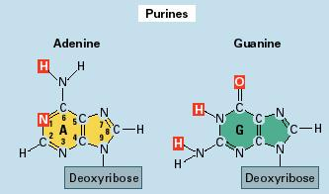
DNA Structure
A polymer with an information-rich sequence of nucleotides
Pyrimidine
6 membered ring made of carbon and nitrogen atoms
Cytosine and thymine
Purine
6 membered ring fused to a five membered ring
Adenine and guanine
Phosphodiester
Covalent bonds holding nucleotides together

Slide 9
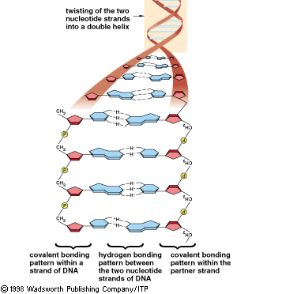
DNA Structure, cont.
5’ ATGCTGCGTTAAATT 3’
3’ TACGACGCAATTTAA 5’
Double helix
Two chains of nucleotides that spiral around an imaginary axis
Hydrogen bonds
Hold two chains of nucleotides together
Adenine pairs with thymine (A-T)
Cytosine pairs with guanine (G-C)
Two strands of DNA double helix are complimentary
G
C
A
T

Slide 10
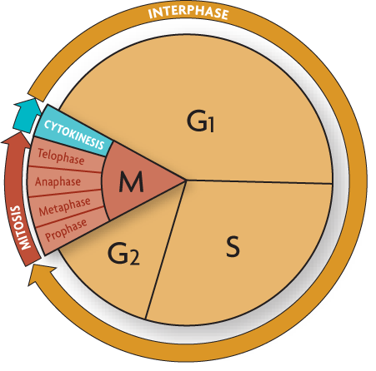
Replication copies the genetic information.
A single strand of DNA serves as a template for a new strand.
The rules of base pairing direct replication.
DNA is replicated during the S (synthesis) stage of the cell cycle.
Each body cell gets a complete set of identical DNA.

Slide 11
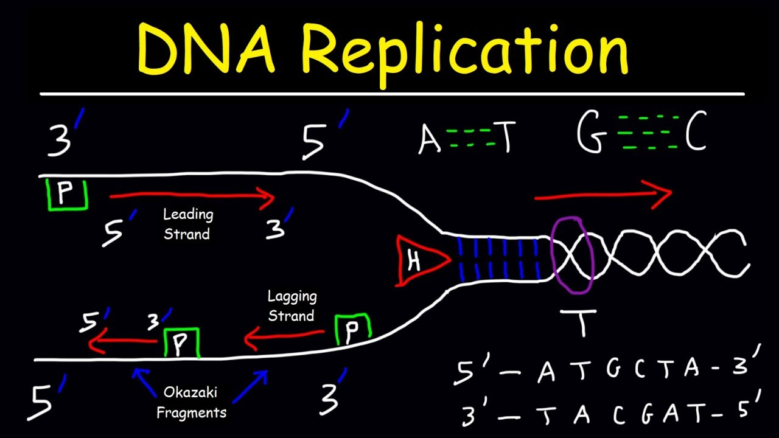

Slide 12


Slide 13
RNA- RIBONUCLEIC ACID

Slide 14
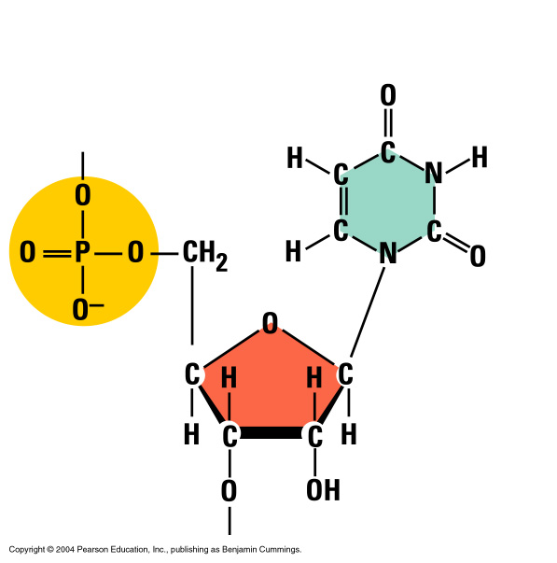
RNA – Ribonucleic Acid
Ribose sugar has an extra –OH or hydroxyl group
It has the base uracil (U) instead of thymine (T)
Nitrogenous base
(A,G,C, or U)
Uracil
Phosphate
group
Sugar (ribose)

Slide 15
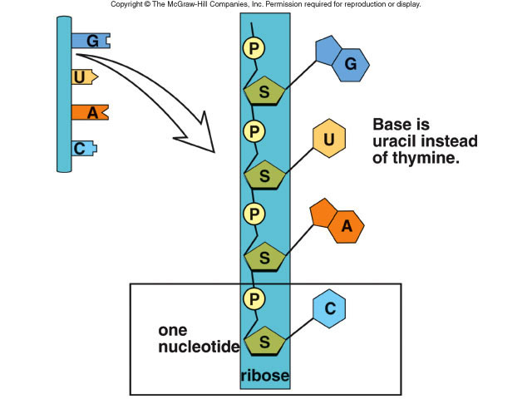
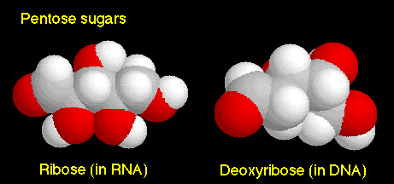
RNA Differs from DNA
1. RNA has a sugar ribose
DNA has a sugar deoxyribose
2. RNA contains the base uracil (U)
DNA has thymine (T)
3. RNA molecule is single-stranded
DNA is double-stranded

Slide 16
Three Types of RNA
.
Messenger RNA (mRNA) carries genetic information to the ribosomes
(blueprint for the construction of a protein)
Ribosomal RNA (rRNA), along with protein, makes up the ribosomes
(construction site where the protein is made)
Transfer RNA (tRNA) transfers amino acids to the ribosomes where proteins are synthesized
(truck delivering the proper amino acid to the site at the right time)
Notes:
16
16

Slide 17
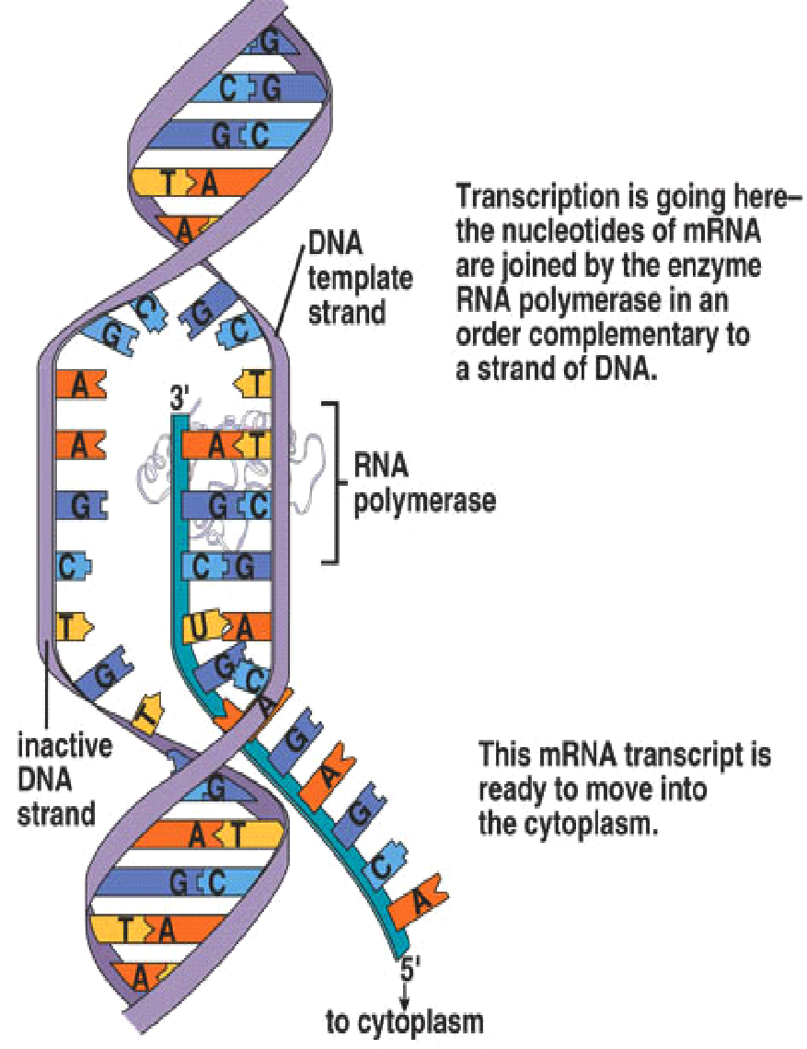
Overview of Transcription
During transcription in the nucleus, a segment of DNA unwinds and unzips, and the DNA serves as a template for mRNA formation
RNA polymerase joins the RNA nucleotides so that the codons in mRNA are complementary to the triplet code in DNA
The transfer of information in the nucleus from a DNA molecule to an RNA molecule
Only 1 DNA strand serves as the template
Starts at promoter DNA (TATA box)
Ends at terminator DNA (stop)
When complete, pre-RNA molecule is released
Notes:
17
17

Slide 18
RNA Polymerase
Enzyme found in the nucleus
Separates the two DNA strands by breaking the hydrogen bonds between the bases
Then moves along one of the DNA strands and links RNA nucleotides together
DNA
RNA Polymerase
pre-mRNA
Notes:
18
18

Slide 19
Processing Pre-mRNA
Also occurs in the nucleus
Pre-mRNA made up of segments called introns & exons
Exons code for proteins, while introns do NOT!
Introns spliced out by splicesome-enzyme and exons re-join
End product is a mature RNA molecule that leaves the nucleus to the cytoplasm
pre-mRNA molecule
exon
intron
exon
intron
exon
intron
intron
exon
exon
exon
splicesome
splicesome
exon
exon
exon
Mature RNA molecule

Slide 20
Messenger RNA (mRNA)
Carries the information for a specific protein
Made up of 500 to 1000 nucleotides long
Sequence of 3 bases called codon
AUG – methionine or start codon
UAA, UAG, or UGA – stop codons
start
codon
A
U
G
G
G
C
U
C
C
A
U
C
G
G
C
G
C
A
U
A
A
mRNA
codon 1
codon 2
codon 3
codon 4
codon 5
codon 6
codon 7
protein
methionine
glycine
serine
isoleucine
glycine
alanine
stop
codon
Primary structure of a protein
aa1
aa2
aa3
aa4
aa5
aa6
peptide bonds

Slide 21
Transfer RNA (tRNA)
Made up of 75 to 80 nucleotides long
Picks up the appropriate amino acid floating in the cytoplasm
Transports amino acids to the mRNA
Have anticodons that are complementary to mRNA codons
Recognizes the appropriate codons on the mRNA and bonds to them with H-bonds
Four ATP’s are required for each amino acid added to the polypeptide chain:Two to "charge" the tRNA , one to carry the charged tRNA to the ribosome and one to move the ribosome to the next codon.
amino acid
attachment site
methionine
U
A
C
anticodon

Slide 22
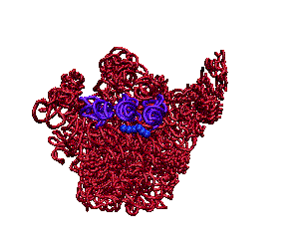
Ribosomal RNA (rRNA)
Made up of rRNA is 100 to 3000 nucleotides long
Made inside the nucleus of a cell
Associates with proteins to form ribosomes
Ribosomes
Made of a large and small subunit
Composed of rRNA (40%) and proteins (60%)
Have two sites for tRNA attachment --- P and A
Notes:
22
22

Slide 23
Ribosomes
P= Peptide site
A= Amino acid site
Large
subunit
P
Site
A
Site
mRNA
A
U
G
C
U
A
C
U
U
C
G
Small subunit
Notes:
23
23

Slide 24
REPLICATION
DNA
DNA
TRANSCRIPTION
RNA
TRANSLATION
PROTEINS
CENTRAL DOGMA OF LIFE

Slide 25
Genes & Proteins
Proteins are made of amino acids linked together by peptide bonds
20 different amino acids exist
Amino acids chains are called polypeptides
Segment of DNA that codes for the amino acid sequence in a protein are called genes
Genetic Code:
DNA contains a triplet code
Every three bases on DNA stands for ONE amino acid
Each three-letter unit on mRNA is called a codon
Most amino acids have more than one codon!
There are 20 amino acids with a possible 64 different triplets
The code is nearly universal among living organisms
Notes:
25
25

Slide 26
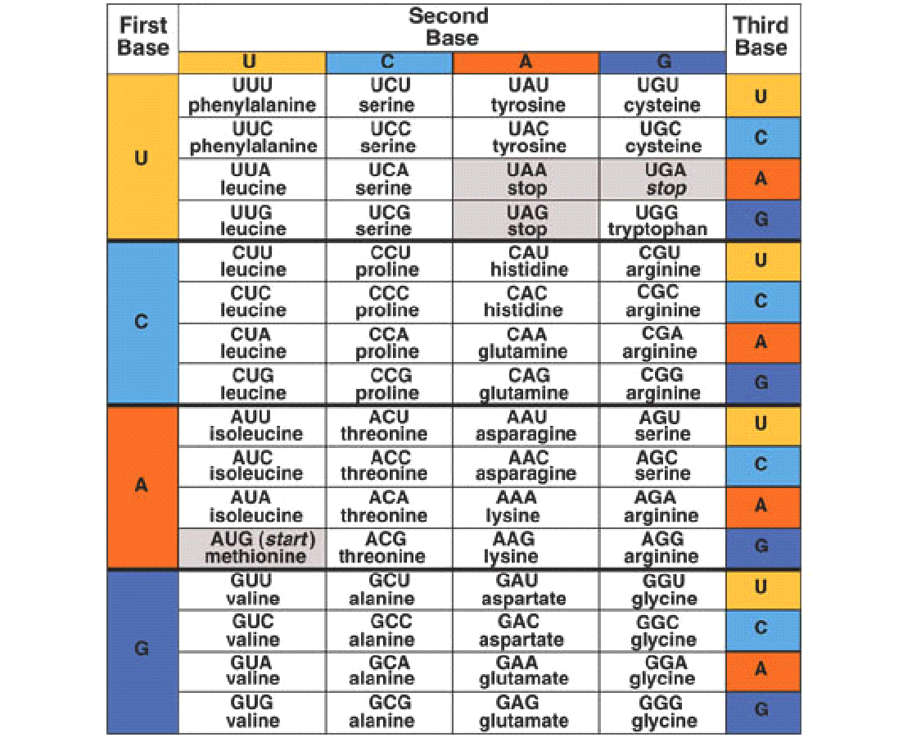
26

